Slide 1
Beer Ratings Analysis & Prediction
MSDS 6306 Case study 2
Bhuvana Adur Kannan
Christopher Ballenger
Selwyn Samuel

Slide 2
Outline
Project Goals
Data Gathering
Feature Selection
Modeling
Results

Slide 3
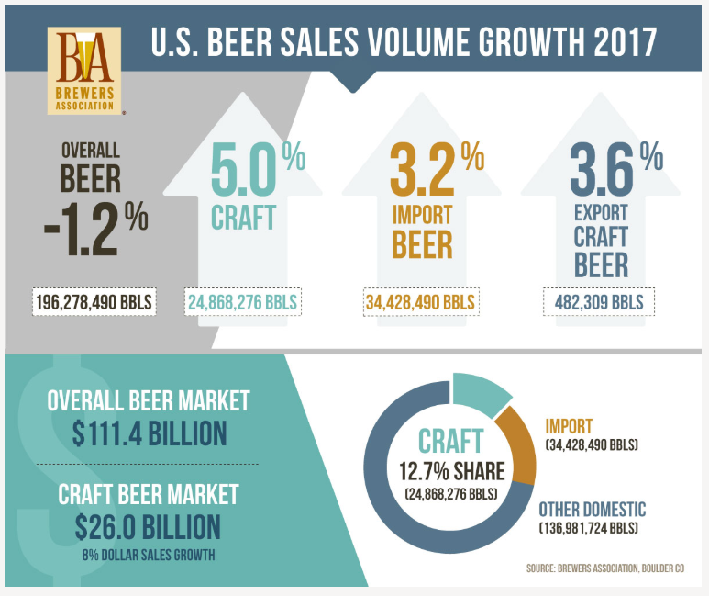
Beer Industry
Trend
Overall beer sales down 1%
Craft & Import beer sales up 8%
23% of overall beer sales
Beer drinkers are turning into beer enthusiasts & beer connoisseurs
For me, it equates to a sense of adventure – collecting sensory experiences through flavor profiles like Indiana Jones collects priceless artifacts. The excitement of a satisfying brew, falling into off-flavors – these experiences belong in the museum of your mind!
- Katy Tilley (DESTIHL Brewery Ambassador)
Source: https://www.brewersassociation.org

Slide 4
Questions
Is there a bias in the way beer enthusiasts rate a beer at a brewery location and other locations?
Can we predict an introductory market or area where a beer will be successful?
When a beer enthusiast/connoisseur walks into a brewery can we recommend a beer that he/she would like based on their past ratings profile?

Slide 5
Project Goals
Data Science Project Life Cycle
Apply Statistics lessons from MSDS 6371
Problem analysis & Identification of tests
Learn new technologies
APIs, Web Scraping, ML algorithms,
Learn the model and not Perfect the model
Run evaluations on the model
Report statistics on the model

Slide 6
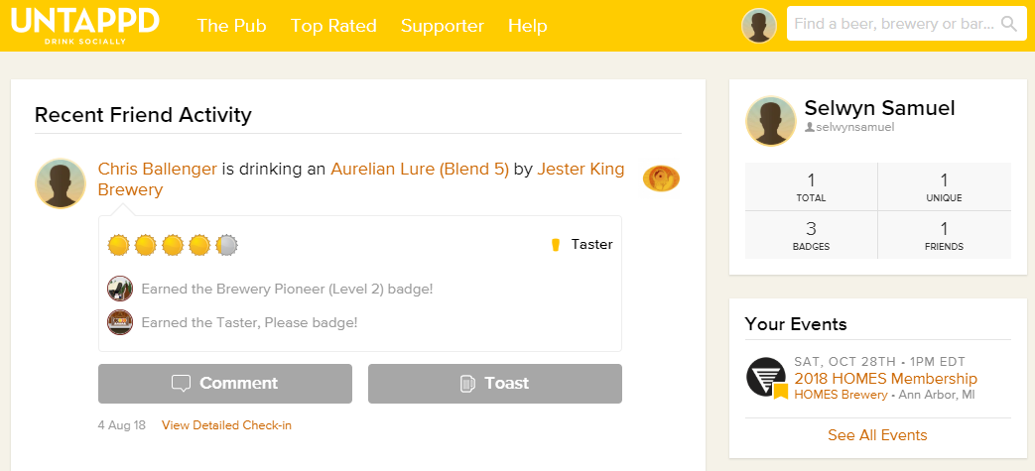


Data Gathering
Get JSON Objects – R
Convert JSON to CSV files
Merge
5 Users, 300+ check-ins, 1500 observations
1100 beer details
rvest & Rselenium packages, CSS Selector
Tricky show more logic
HTML parse -> data frame -> CSV files
API
Web Scraping
Long API Client approval process
100 Calls per hour restriction
IP Black-listed – Intelligent Proxies
Throttle http calls
Source: https://untappd.com/

Slide 7
Breweries we targeted

Slide 8
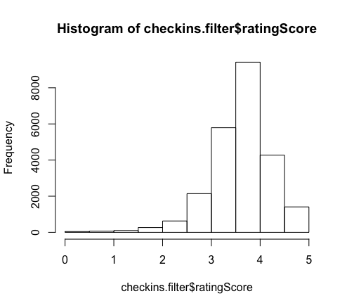
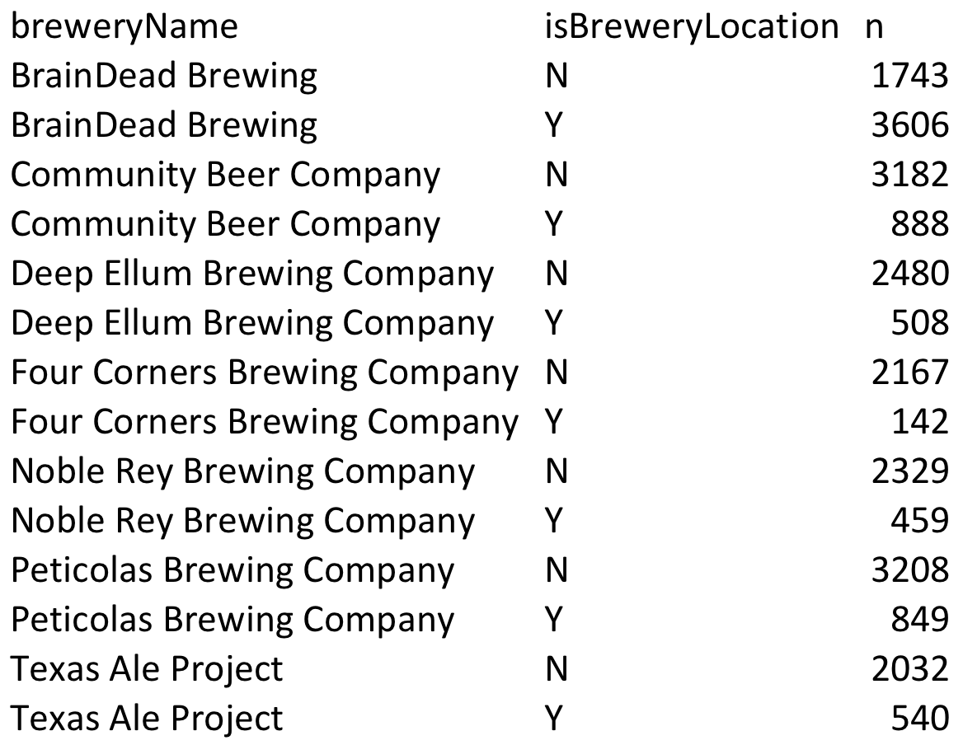
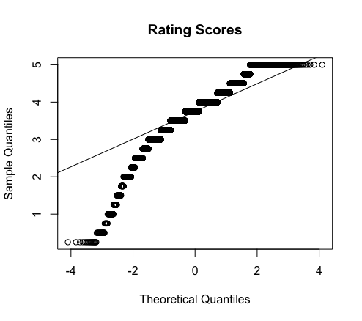
Bias in how we rate beers - Assumptions
The does not appear to come from a normal distribution, however given its large sample size CLT will be robust from violations.

Slide 9
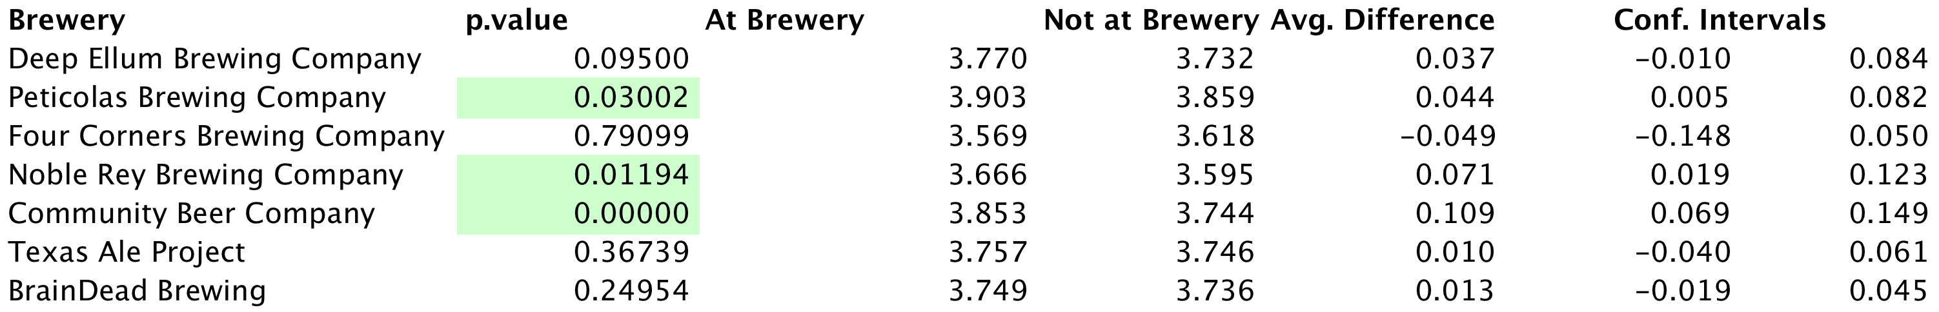
Conclusion
At a significant level of .05, Peticolas, Nobel Rey, and Community mean rating is greater while consumed at the brewery versus not at the brewery. A 95% confident intervals are listed above.
This was an observational study thus no inference can be inferred from the study. The data was consumed from one week worth of 300 check-ins per beer and not a random sample. We can only inferred the outcome from this population.
Full test can be found on our github repository: LocationBias.Rmd

Slide 10
Where are people checking in beers?

Slide 11
Beer Recommendation - Data Gathering
5 Users, 300+ check-ins, 1500 observations
1100 beer details
rvest & Rselenium packages, CSS Selector
Tricky show more logic
HTML parse -> data frame -> CSV files
Web Scraping
IP Black-listed – Intelligent Proxies
Throttle http calls
Master User Profile
Master Beer Details
Source: https://untappd.com/

Slide 12
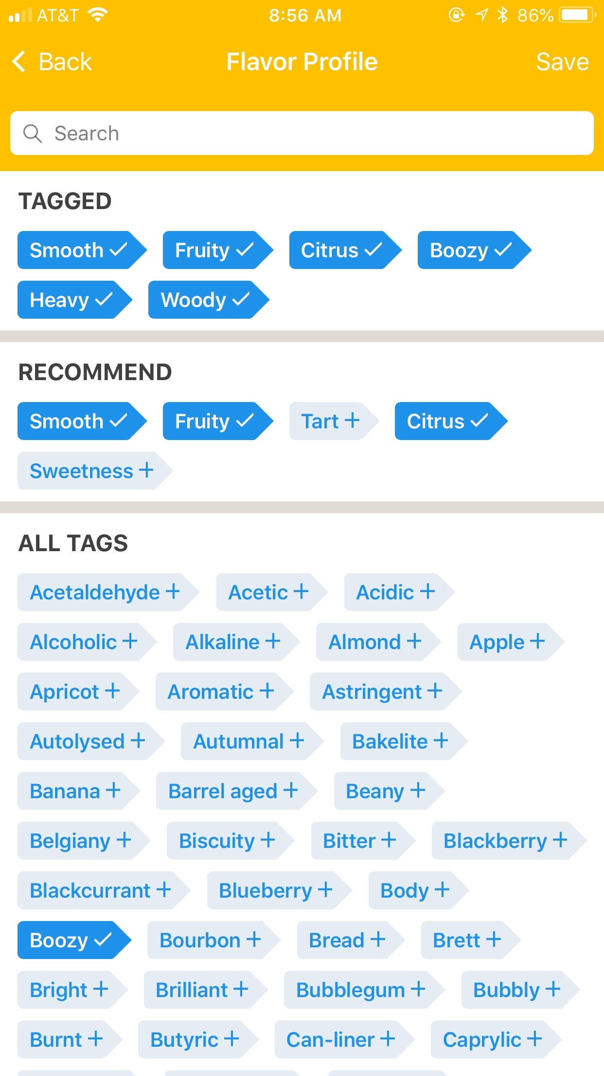
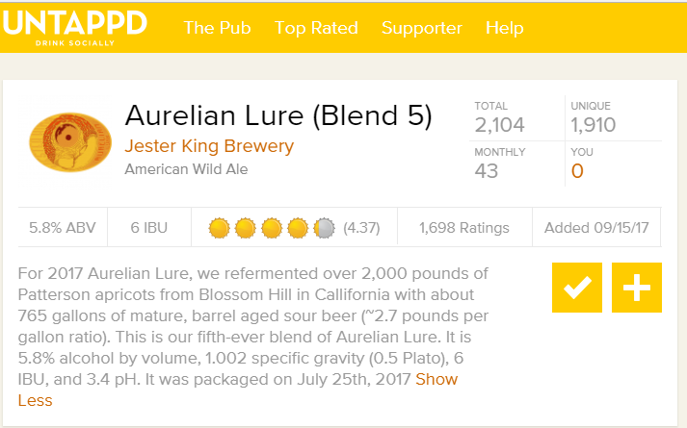
Beer Recommendation - Feature Selection
User selects flavors of a beer while checking in
Chose 40 out of the 100+ flavors to define a beer
Extract flavor keywords from beer description
Add beer features like ABV, IBU
ABV, IBU, Style, Light, Smooth, Clean, Sweet, Woody, Zippy, Strong, Hoppy, Floral, Citrus, Milk, Dark, Creamy, Mouthfeel, Soft, Boozy, Caramel, Oatmeal, Dry, Malty, Piney, Grassy, Tart, Sour, Salty, Fruity, Heat, Bitter, Coffee, Roasty, Chocolate, Juicy, Funky, Acidic, Crushable, User Name
Beer description
Check-in Flavor Profile
Source: https://untappd.com/

Slide 13
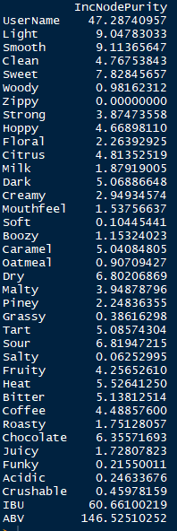
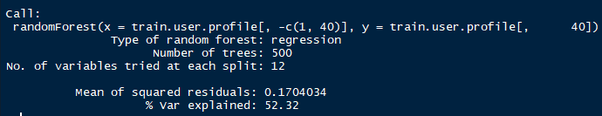
Beer Recommendation - Modeling
Random Forest – First Iteration
1555 Observations, 40 Features
80% training data, 20% testing data
Ratings – Ordinal 1 to 5 with 0.25 increments
Results/Challenges
Prediction rating was continuous (3.54, etc.,)
% var explained: 52.41 – Not very good
Mean Squared Residuals – 0.1704
Beer flavor features were not useful as they were not populated enough to have an impact on the ratings

Slide 14
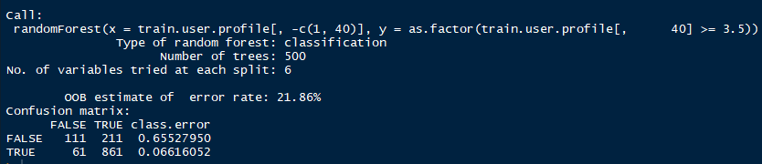
Beer Recommendation - Modeling
Random Forest – Second Iteration
1555 Observations, 40 Features
80% training data, 20% testing data
Ratings – 3.5 above – ThumsUp, else ThumsDown
Results

Slide 15
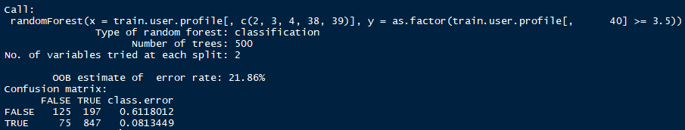
Beer Recommendation - Modeling
Random Forest – Third Iteration
1555 Observations, Top 5 Features
80% training data, 20% testing data
Ratings – 3.5 above – ThumsUp, else ThumsDown
Results

